Slide 1


Travel Assured
Customer behavior Analysis

Slide 2
Overview
Due to the COVID pandemic, the company had to cut it marketing budget by over 50%. It is more important than ever that it advertise in the right places and to the right people.
Goal
Investigate the available data and recommend where the company needs to target for it advertisement

Slide 3
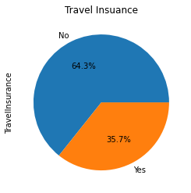
Customer Distribution
64.3% of the customer bought travel insurance.
35.7% of the customer did not bought travel insurance

Slide 4
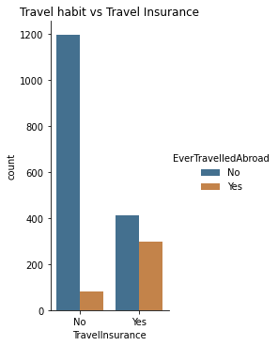
Most Customers with travel insurance have never traveled abroad.
Customers with travel insurance travel abroad more than customer without travel insurance.

Slide 5
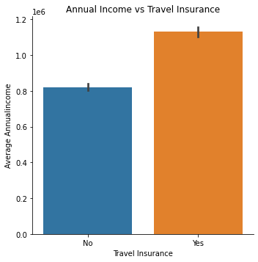
Customer that subscribe for the travel insurance have higher average annual income.

Slide 6
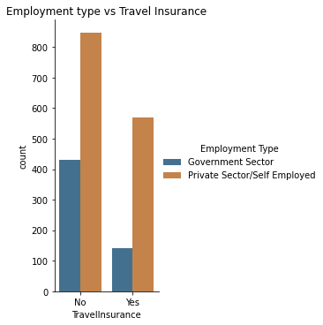
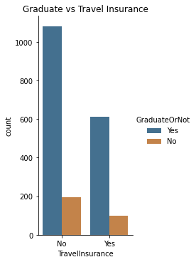
Most of the customers with travel insurance work in private sector and self employed.
Graduate customers subscribe more to the travel insurance compare to customer that are not graduate.
Graduate customers that did not subscribe to the travel insurance are more compare to customers that are not graduate.

Slide 7
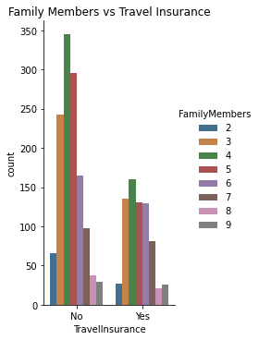
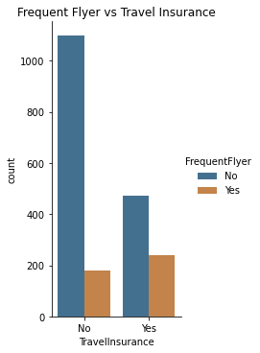
Customers with three to seven children subscribe more to the travel insurance compare to others.
Customer that book frequent tickets subscribe more to travel insurance.

Slide 8
Recommendation
Target customers that have never travelled abroad.
Target customers with higher income.
Target customers in private sectors and self employed.
Target customers that are graduate.
Customer with three to seven children.
Customer without frequent flyer.

